Slide 1
Basics of Computational Biology

Slide 2

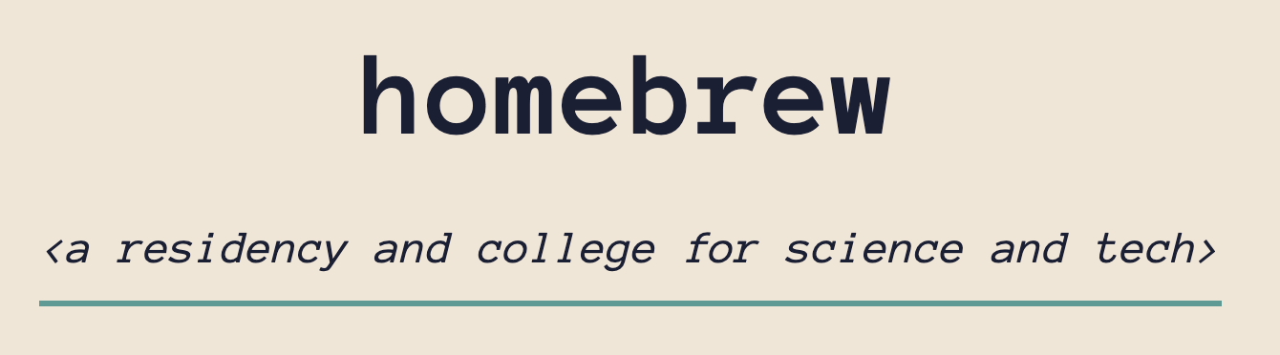
Thank you to our hosts!
Fractal University
Homebrew
Madhu in particular

Slide 3
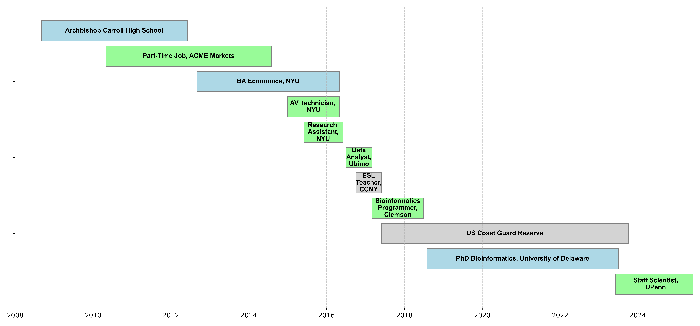
Quick About Me

Slide 4
What is computational biology?

Slide 5
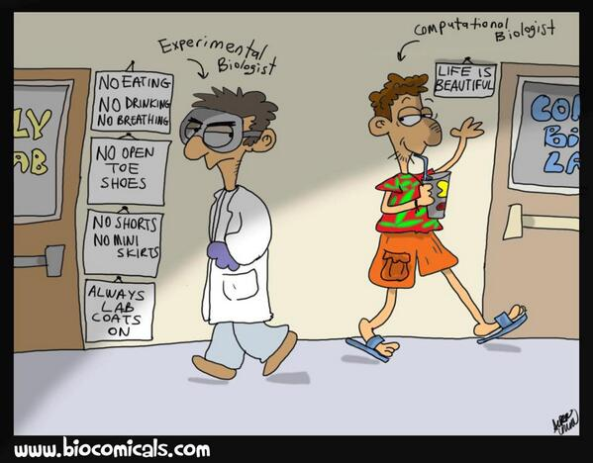
Synonyms / partial-synonyms
Bioinformatics
Quantitative biology
Systems biology
Theoretical biology
Mathematical biology
Biostatistics

Slide 6
Topics we WON’T cover today
Math modeling of biological systems
(but if you’re interested in this, check out my Youtube videos!)
Algorithm design for sequence processing
“Low-level” bioinformatics: getting from raw experimental output to Excel file
Software development
Biomedical engineering
Public health / clinical informatics

Slide 7
Our focus: data analysis for biology

Slide 8
Approach for this class
Distillation
Biology is a huge, intimidating body of knowledge.
But we only need a couple foundational concepts to get started.
Then, if you decide to go further, you can do a deep dive on whatever topic you’re interested in.
Abstraction
By the time we start writing code, we’ll have turned things into a standard data analysis problem.
We’ll be able to open up the biology in Microsoft Excel and take a look at it.
2 Data Analysis Projects
Today: Gene Expression / Transcriptomics
Tomorrow: Genomics / GWAS

Slide 9
Important Part First

Slide 11
High School Biology Review (not actually that important)

Slide 12
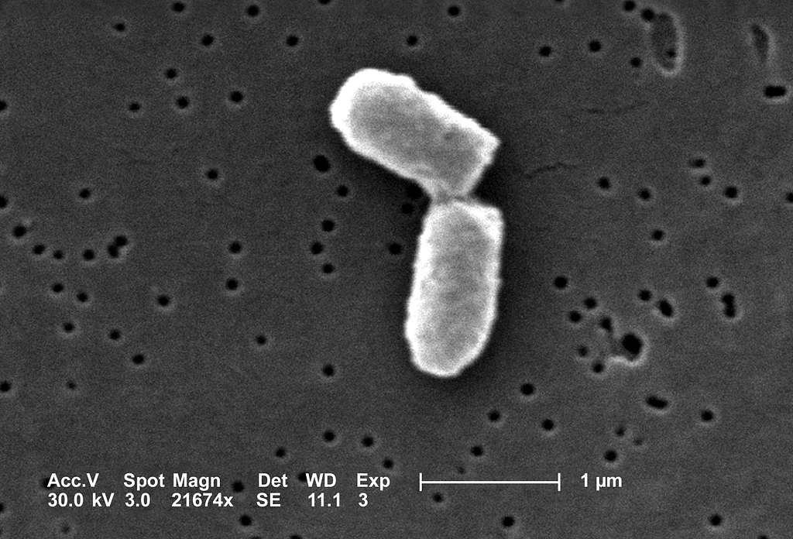
Cells
Smallest unit of life that can function independently
Can perform key functions of life
growth
metabolism
reproduction
Can be single-celled organism (like bacteria) or building block of multicellular organism (like humans)
E. coli cell dividing.
Image source: https://picryl.com/media/ecoli-dividing-27afb2

Slide 13
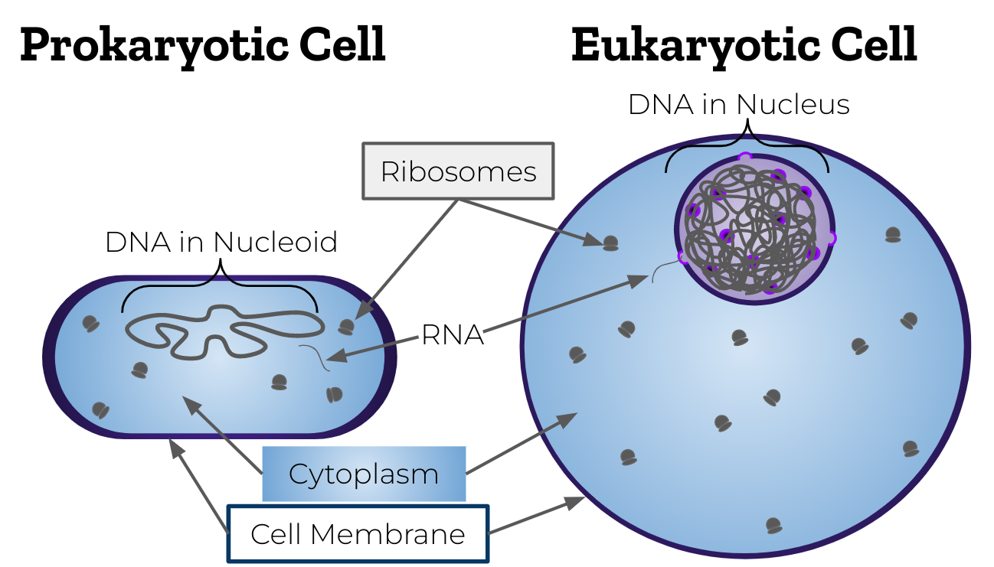
Image source: https://commons.wikimedia.org/wiki/File:Prokaryotic_vs_eukaryotic_cell.png

Slide 14
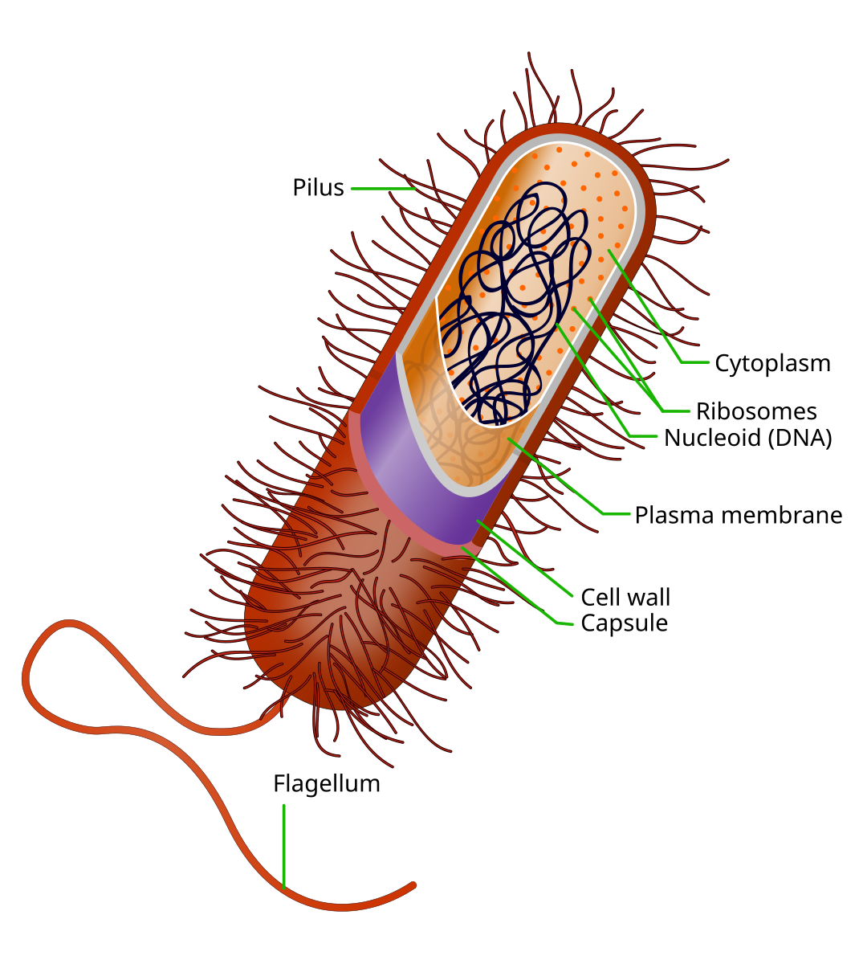
Prokaryotes
Single-celled
Simple structure, no nucleus
Typically smaller than eukaryotes
Examples: bacteria, archaea
Often have external features like flagella and pili for movement
Image source: https://en.wikipedia.org/wiki/File:Prokaryote_cell.svg

Slide 15
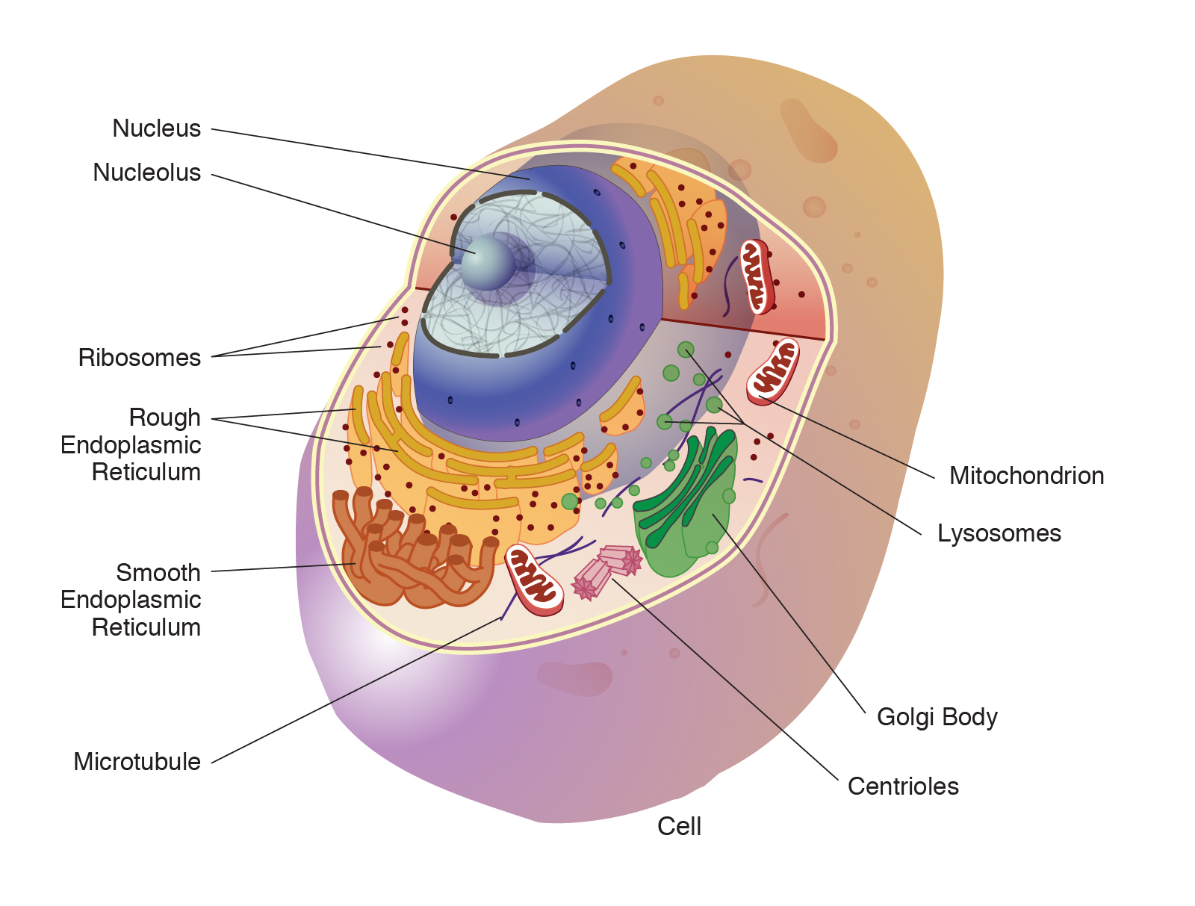
Eukaryotes
Complex structure with membrane-bound organelles, including nucleus
Can be single-celled
protists, yeast
Can be part of multi-cellular organisms
Image source: https://www.genome.gov/genetics-glossary/Organelle

Slide 16
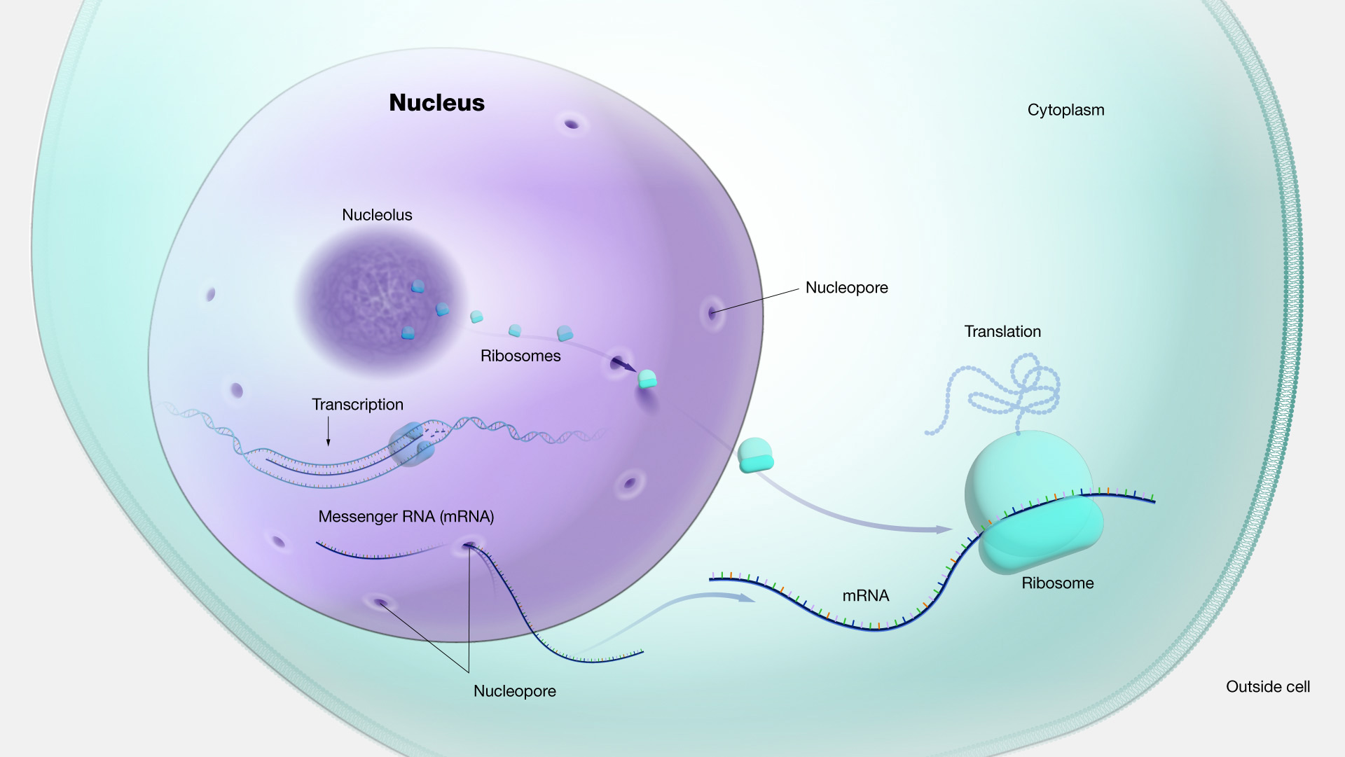
Nucleus
Control center of the cell
Contains the DNA, organized into chromosomes
Contains nucleolus, where ribosomal RNA (rRNA) and proteins are combined to form ribosomal subunits
Image source: https://www.genome.gov/genetics-glossary/Nucleus

Slide 17
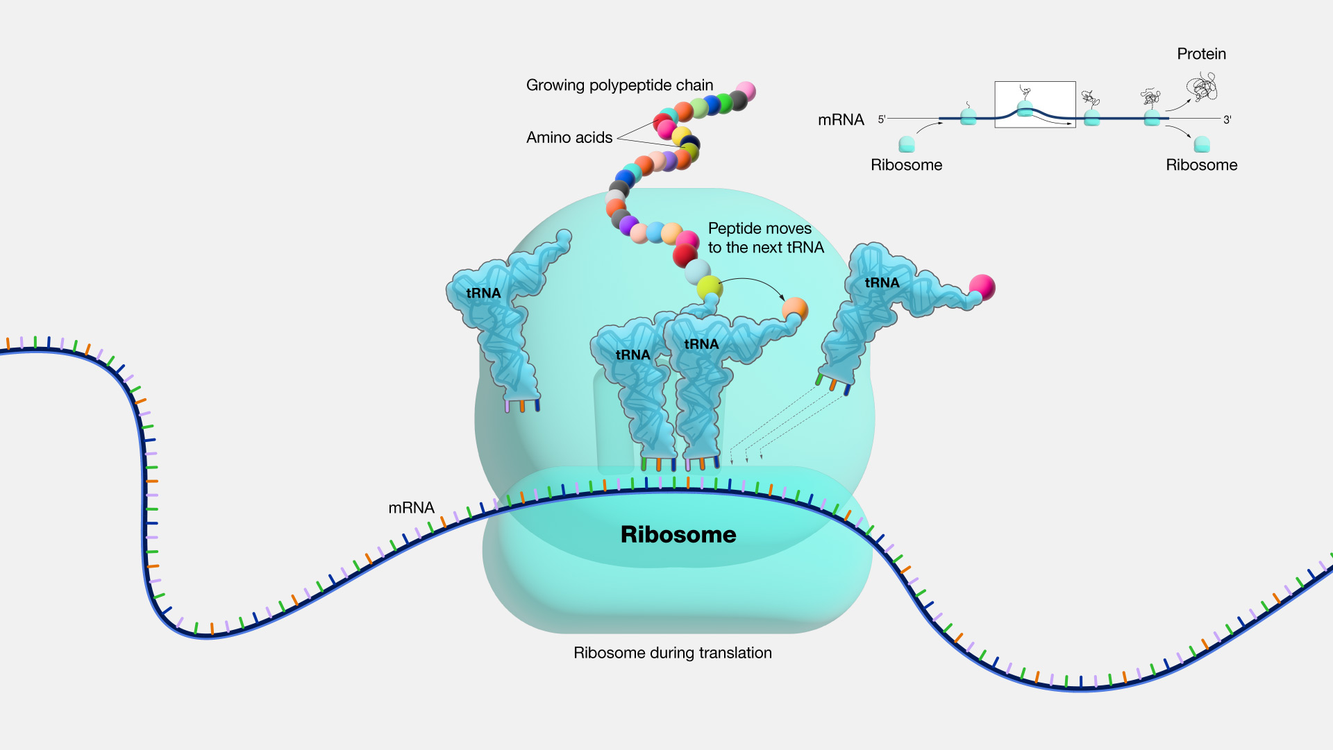
Ribosomes
Site of protein assembly from amino acids, based on mRNA sequence
Image source: https://www.genome.gov/genetics-glossary/Ribosome

Slide 18
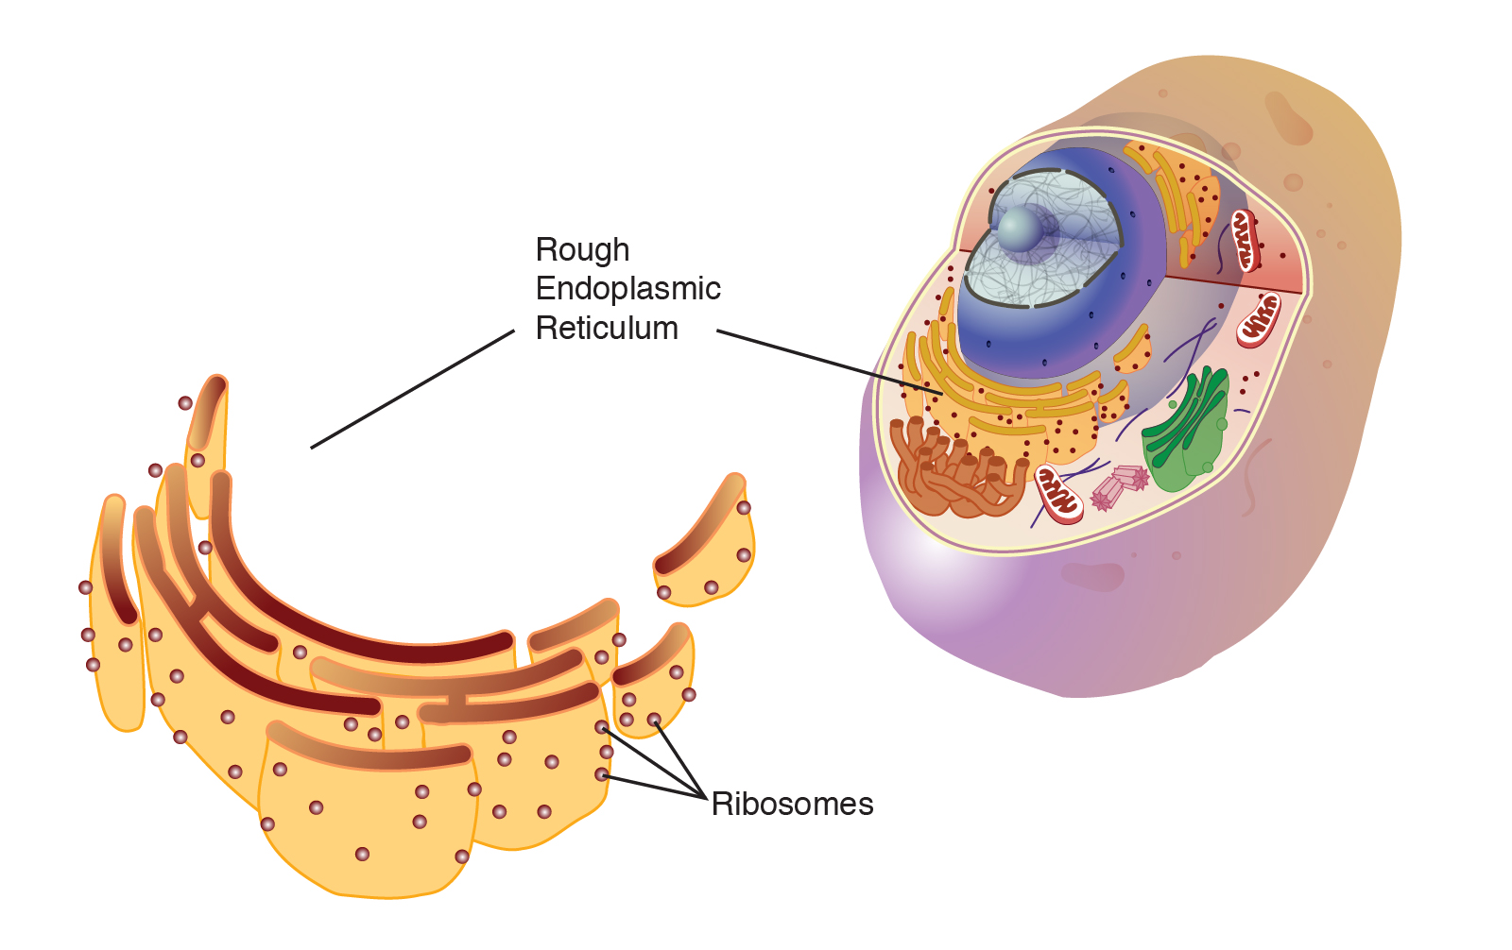
Endoplasmic Reticulum (Rough)
Lined with ribosomes
Involved in protein folding, especially for proteins that are going to be secreted from the cell
Image source: https://www.genome.gov/genetics-glossary/Endoplasmic-Reticulum-rough

Slide 19
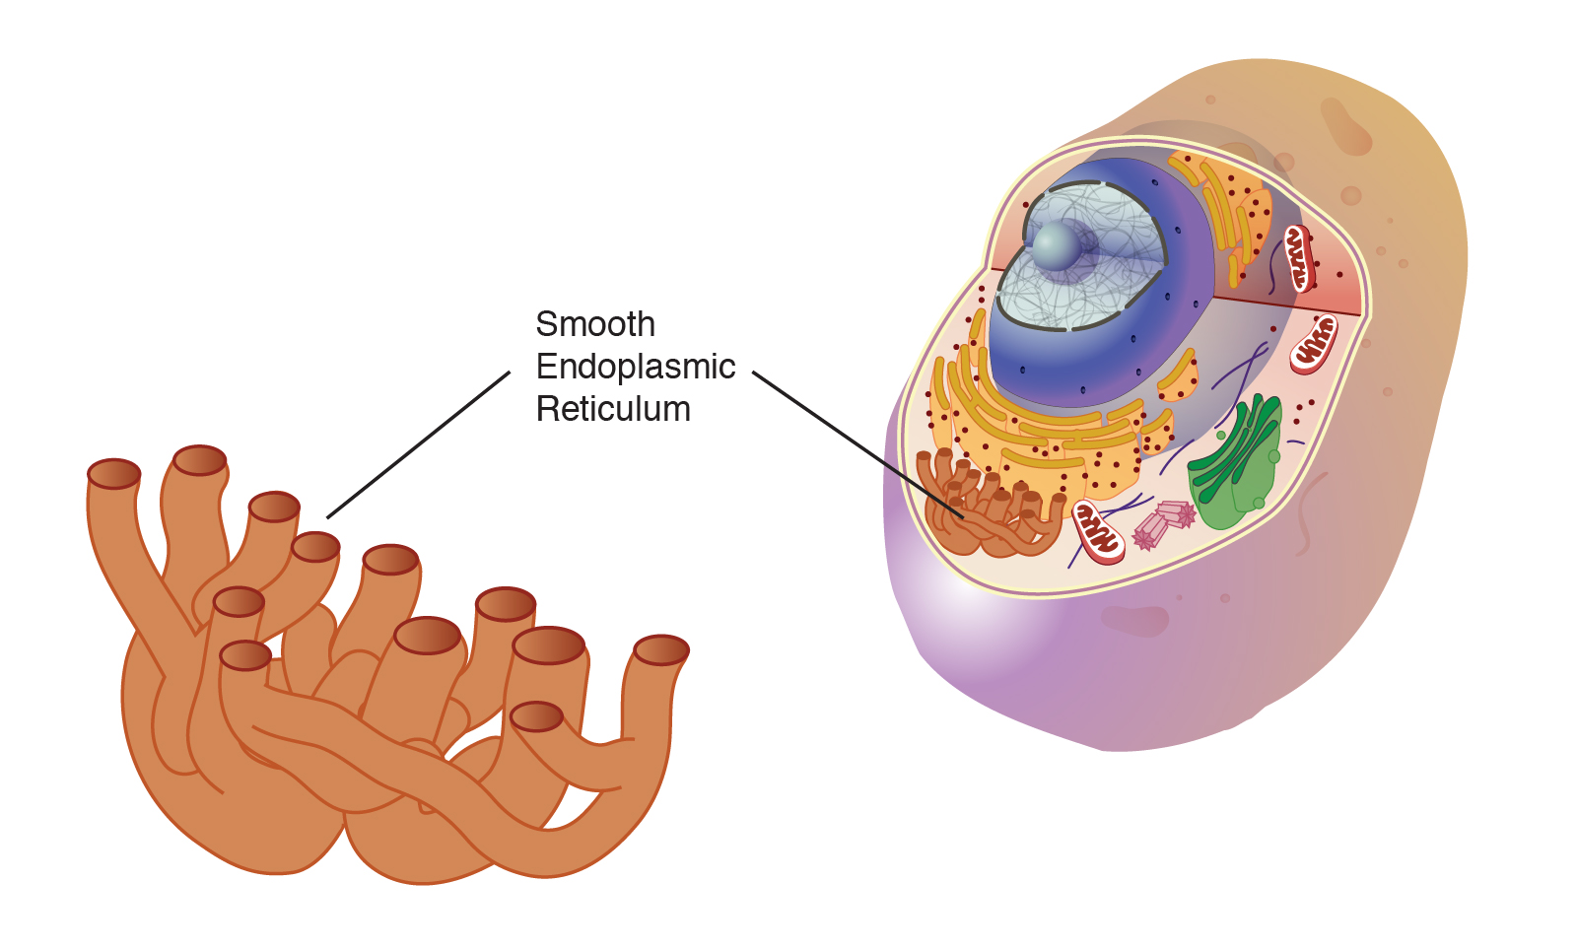
Endoplasmic Reticulum (Smooth)
Not lined with ribosomes
Involved in lipid synthesis
Image source: https://www.genome.gov/genetics-glossary/Endoplasmic-Reticulum-smooth

Slide 20
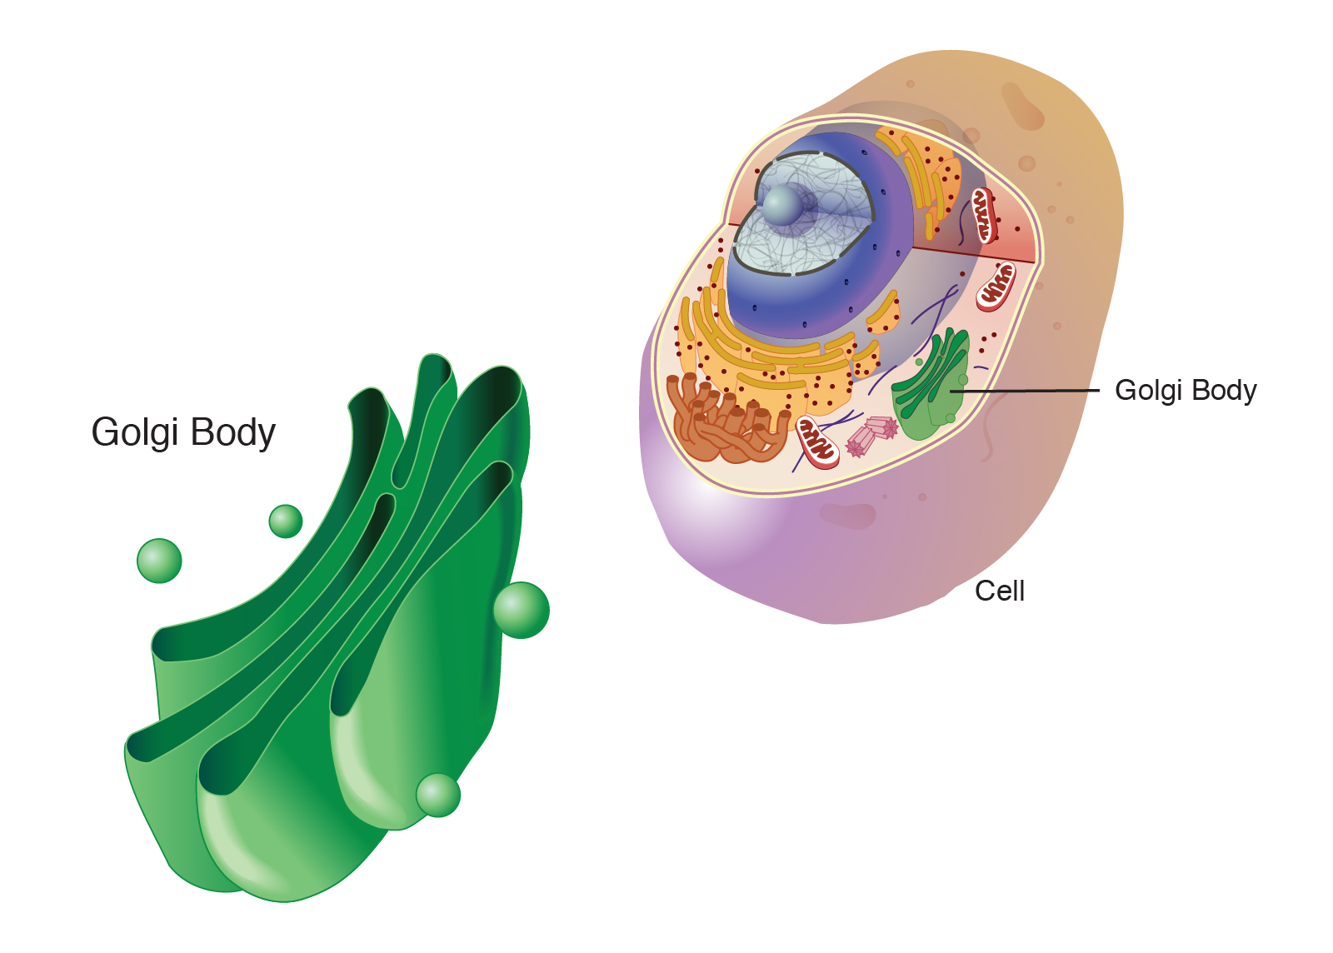
Golgi Body
Modifies and packages proteins and lipids after they’ve gone through the ER
Image source: https://www.genome.gov/genetics-glossary/golgi-body

Slide 21
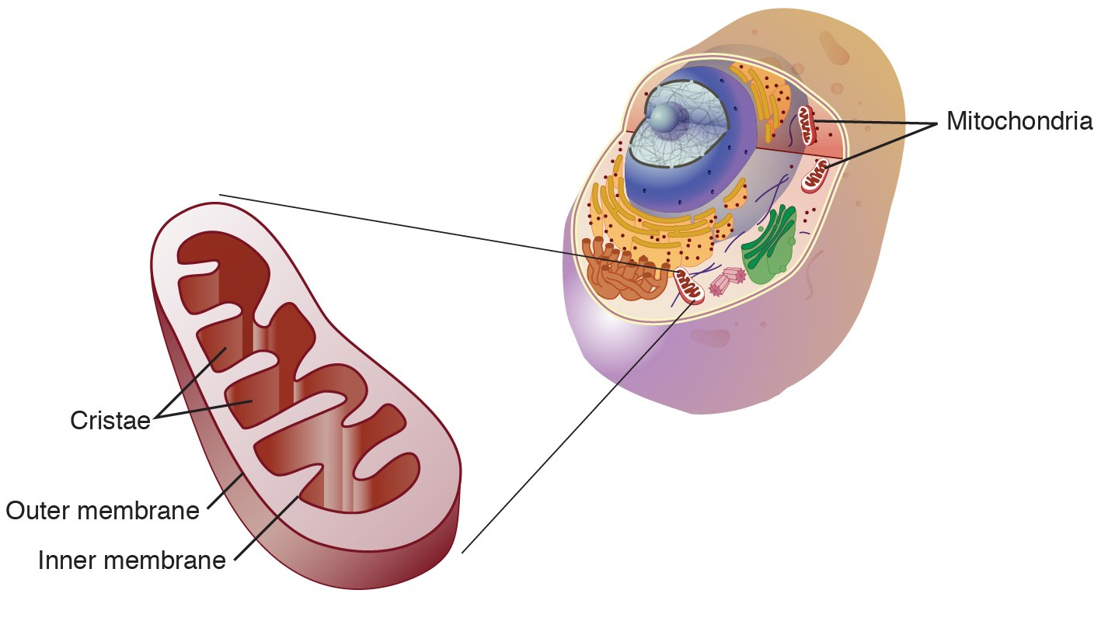
Mitochondria
“Powerhouse of the cell”
Generate ATP through cellular respiration, primarily through the Krebs Cycle (citric acid cycle)
Have their own DNA and can replicate independently of cell
Image source: https://www.genome.gov/genetics-glossary/Mitochondria

Slide 22
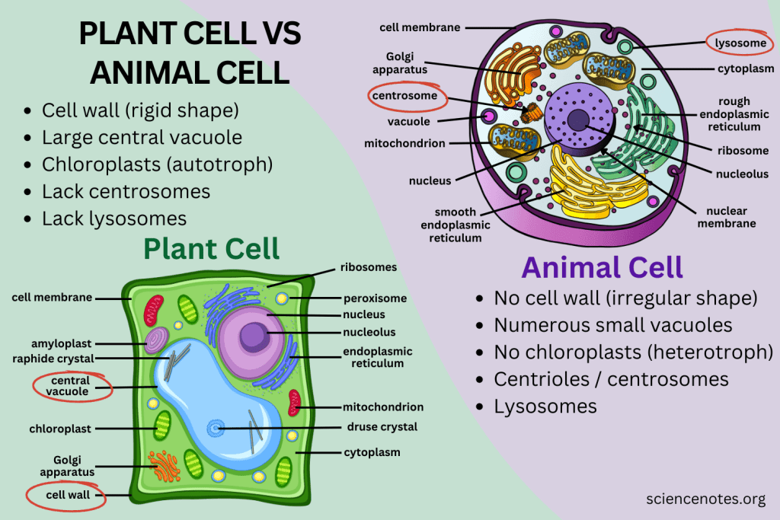
Image source: https://sciencenotes.org/difference-between-plant-and-animal-cells/

Slide 23
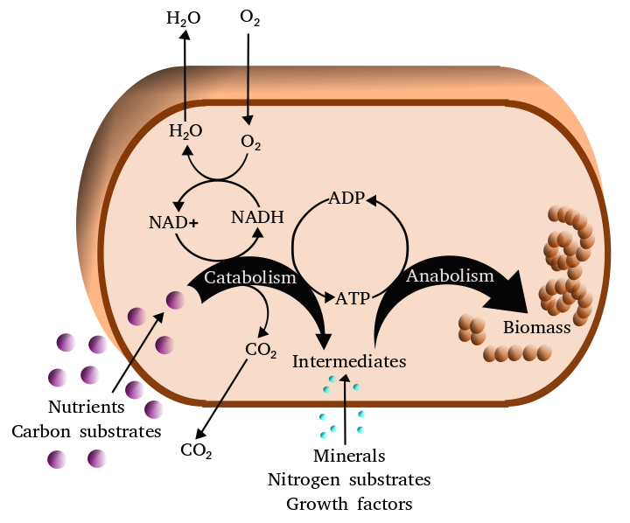
Cell Metabolism
Converting nutrients into energy for use in cellular activities
ATP is energy currency
Catabolism: breaking down molecules to release energy
Anabolism: using energy to build molecules
Image source: https://en.wikipedia.org/wiki/Metabolism#/media/File:Metabolism.png

Slide 24
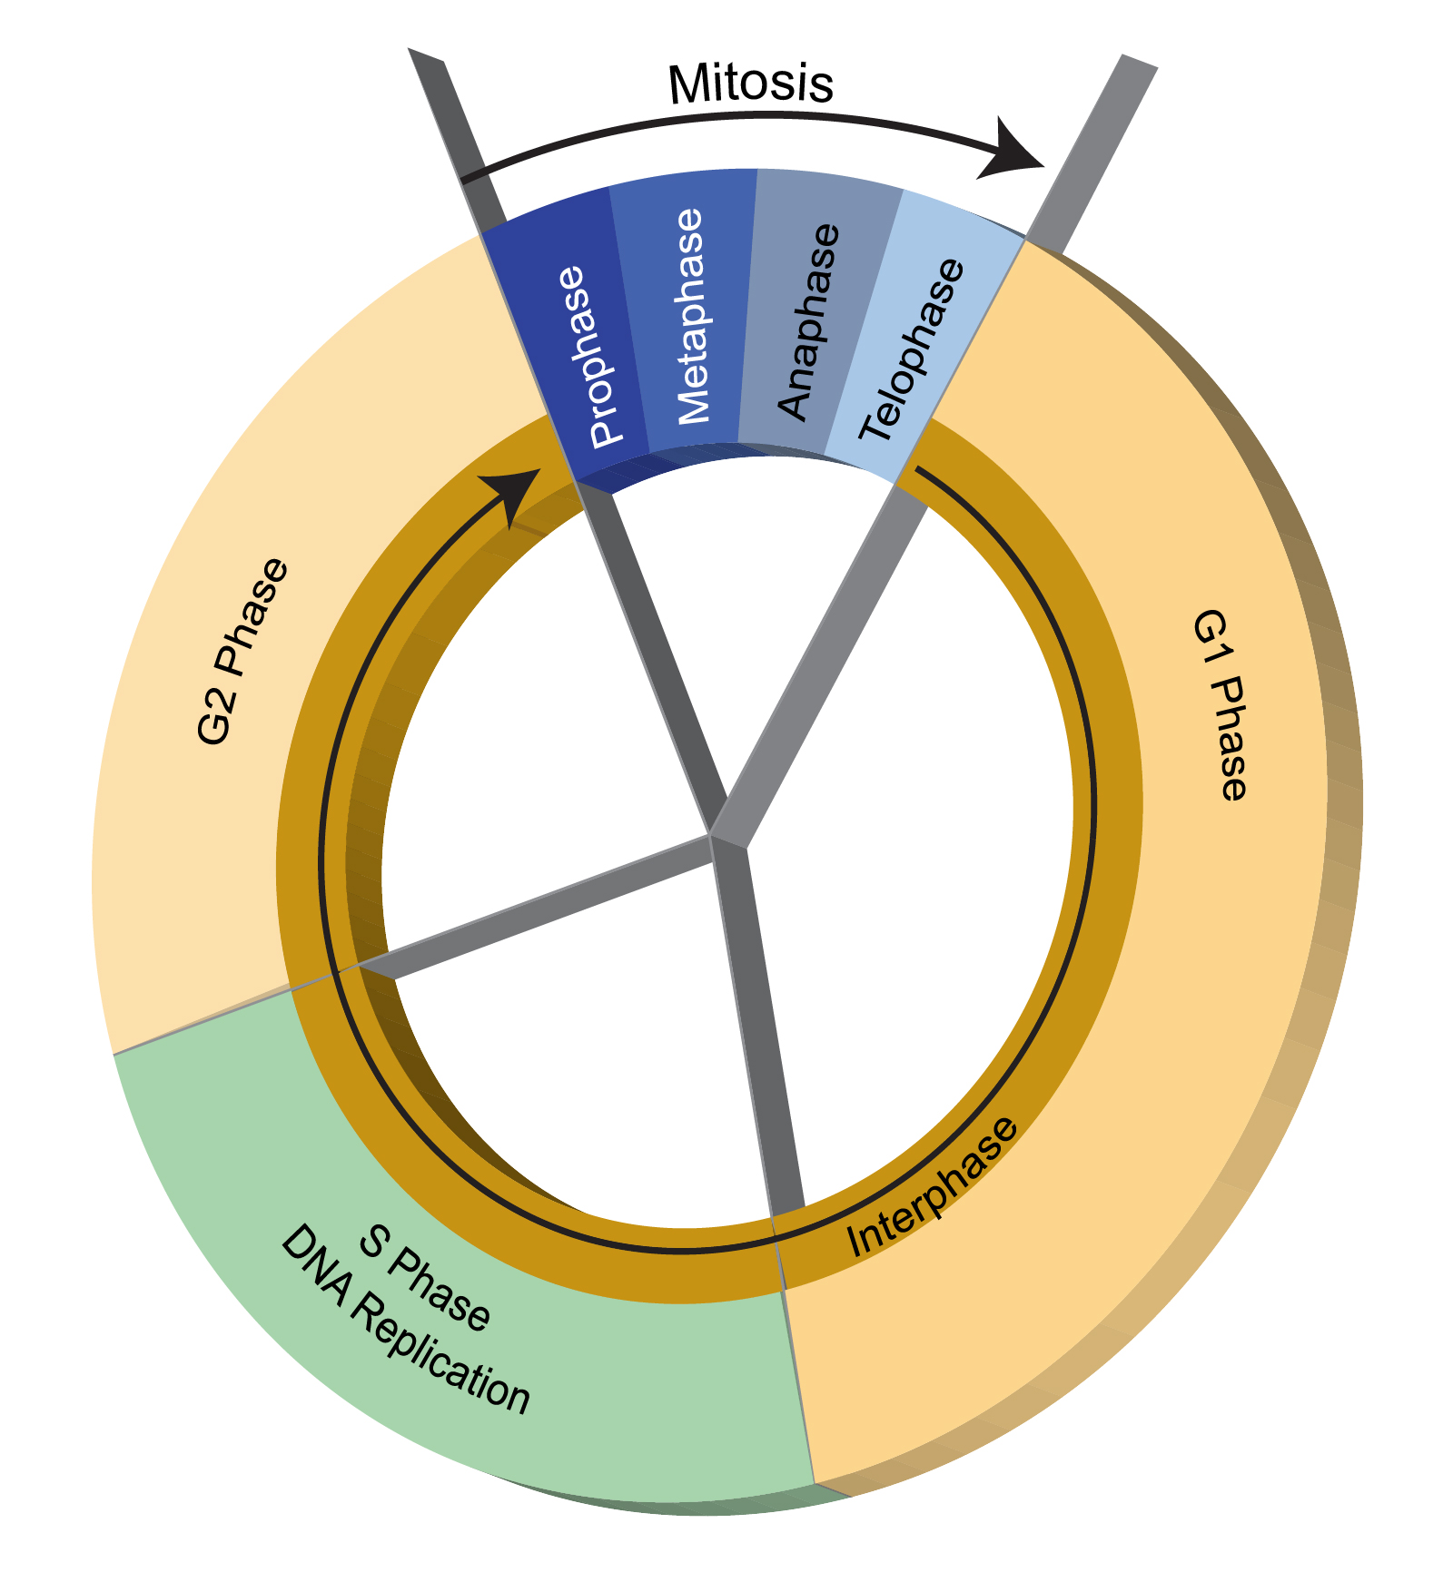
Cell Cycle
G1 Phase: Cell grows, synthesizes proteins and organelles.
S Phase: Cell replicates its DNA, resulting in 2 identical (except for mutations) sets of chromosomes
G2 Phase: Cell continues to grow
M Phase: The cell divides (mitosis)
A cell that is not currently preparing to divide is said to be in G0 Phase, also called quiescence.
This cycle is specific to eukaryotes. Prokaryotes divide through a simpler process called binary fission.
Image source: https://www.genome.gov/genetics-glossary/Cell-Cycle

Slide 25
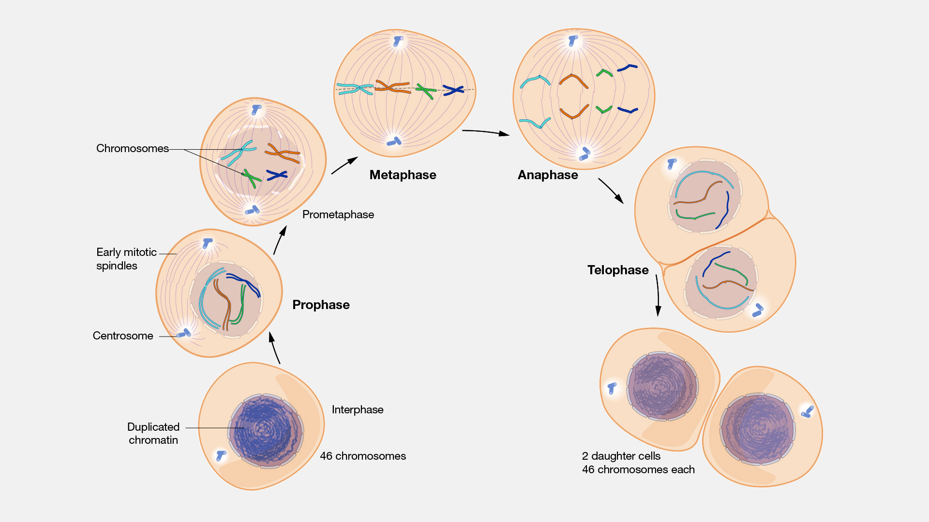
Mitosis
Image source: https://www.genome.gov/genetics-glossary/Mitosis

Slide 26
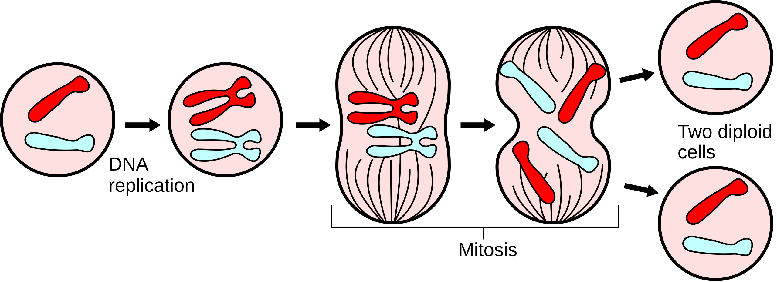
Mitosis
Image source: https://en.wikipedia.org/wiki/Mitosis#/media/File:Major_events_in_mitosis.svg

Slide 27
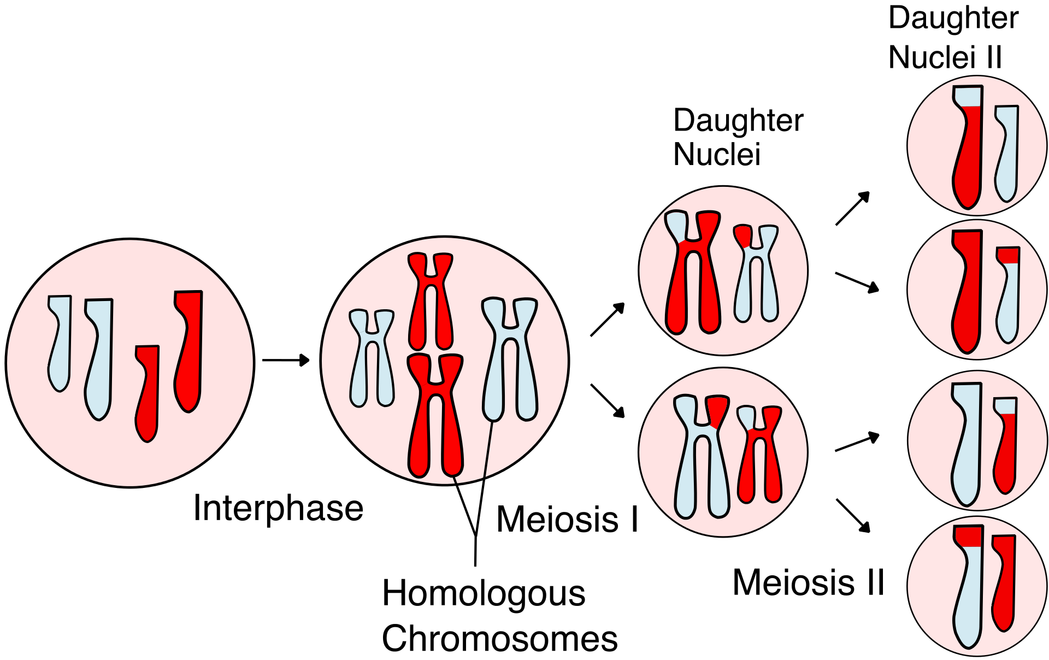
Meiosis
Image source:
https://en.wikipedia.org/wiki/Meiosis#/media/File:Meiosis_Overview_new.svg

Slide 28
Back to the important part

Slide 29
Central Dogma of Molecular Biology

Slide 30
Gene Expression: the process by which information encoded in the DNA is used to make a product (mRNA or protein)
Different gene expression patterns could be signs of interesting biological differences between cells.

Slide 37
Going Deeper on Each Part (good to know but not completely necessary)

Slide 38
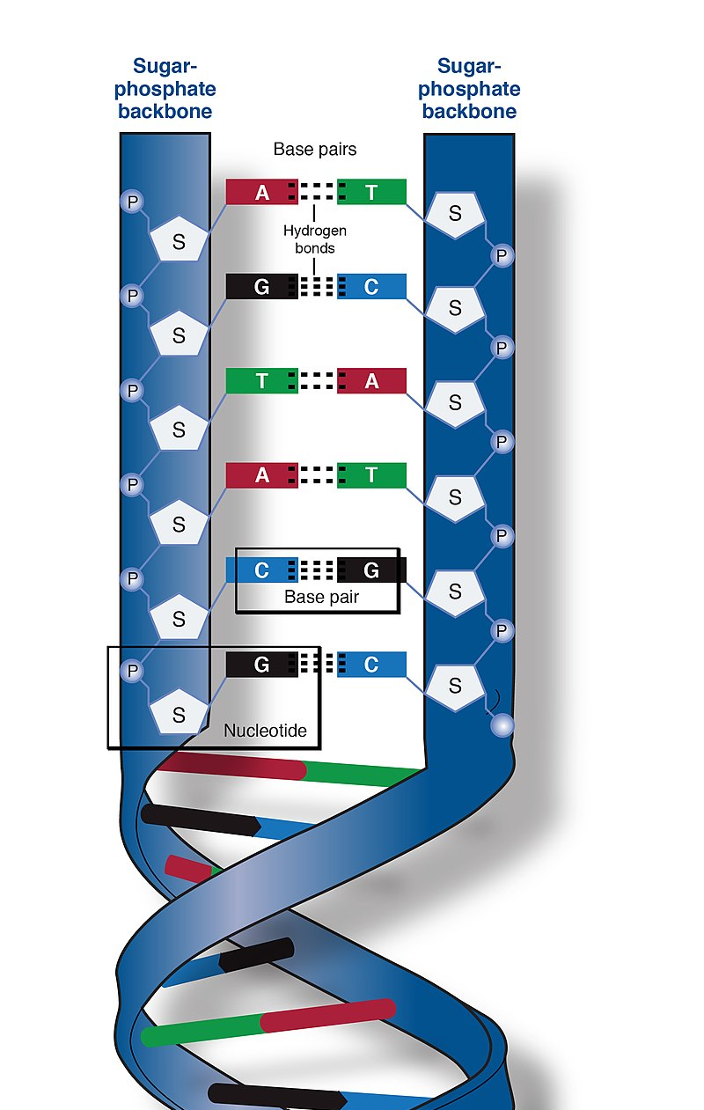
DNA
Four bases:
Adenine
Thymine
Cytosine
Guanine
A and T are complementary
C and G are complementary
Two complementary bases are called a “base pair”
Sequences of base pairs encode information
Image source: https://en.wikipedia.org/wiki/DNA#/media/File:Phosphate_backbone.jpg

Slide 39
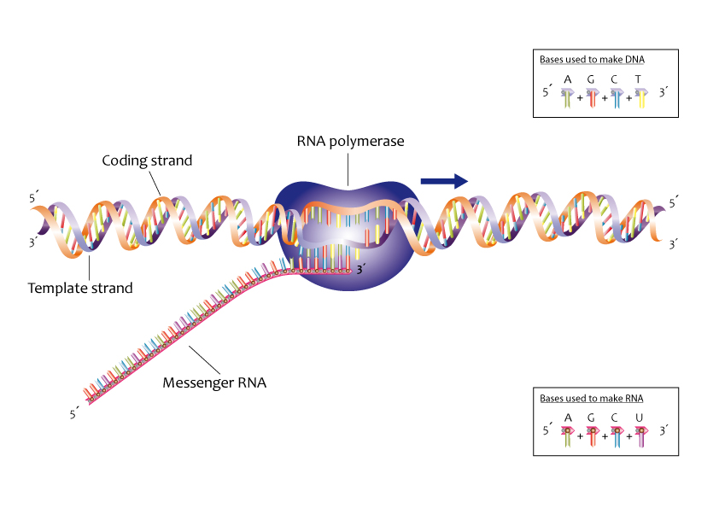
Transcription
Image source: https://commons.wikimedia.org/wiki/File:Process_of_transcription_%2813080846733%29.jpg

Slide 40
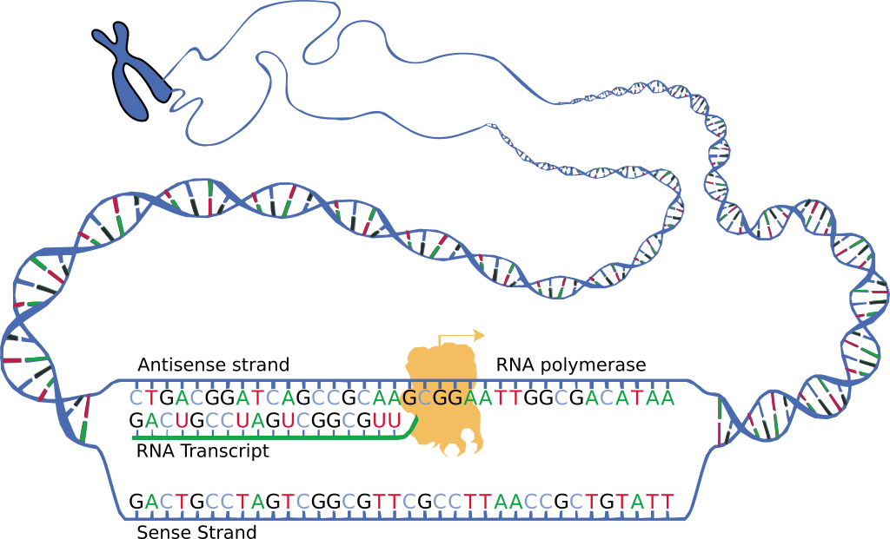
mRNA
Image source: https://en.wikipedia.org/wiki/Messenger_RNA#/media/File:DNA_transcription.svg
Nucleic acid, like DNA
Four bases:
Adenine
Uracil
Cytosine
Guanine
Single stranded (usually)
One of several types of RNA

Slide 41
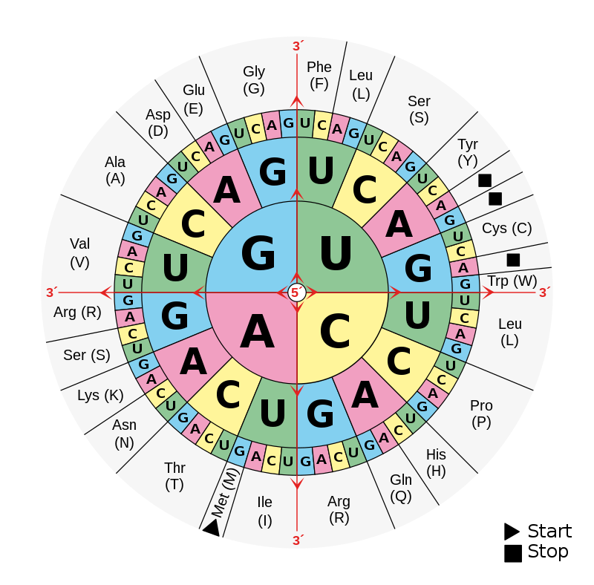
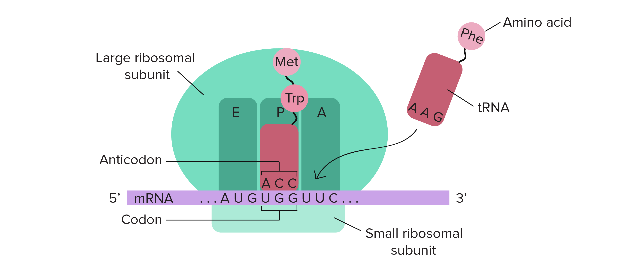
Translation
Image source: https://en.wikipedia.org/wiki/DNA_and_RNA_codon_tables#/media/File:Aminoacids_table.svg
Image source: https://www.khanacademy.org/science/biology/gene-expression-central-dogma/translation-polypeptides/a/the-stages-of-translation

Slide 42
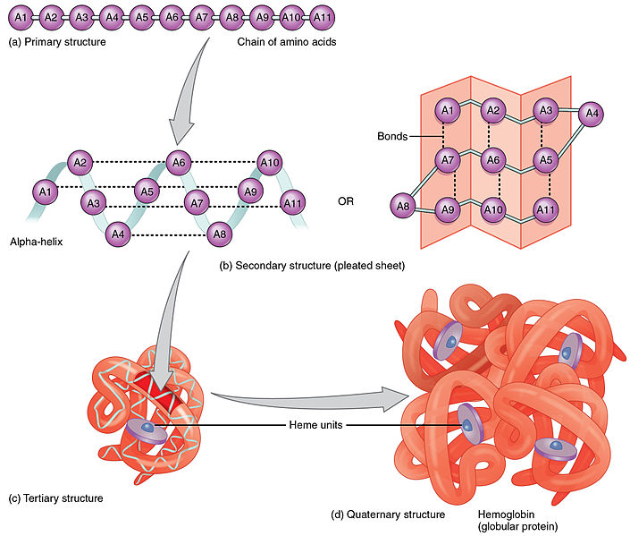
Protein
Image source: https://commons.wikimedia.org/wiki/File:225_Peptide_Bond-01.jpg
Chain of amino acids produced during translation is folded to produce final protein.
Proteins do the work of the cell: catalyzing metabolic reactions, structural support, signaling, regulating cellular processes, etc.

Slide 43
Gene Expression: the process by which information encoded in the DNA is used to make a product (mRNA or protein)
Different gene expression patterns could be signs of interesting biological differences between cells.

Slide 44
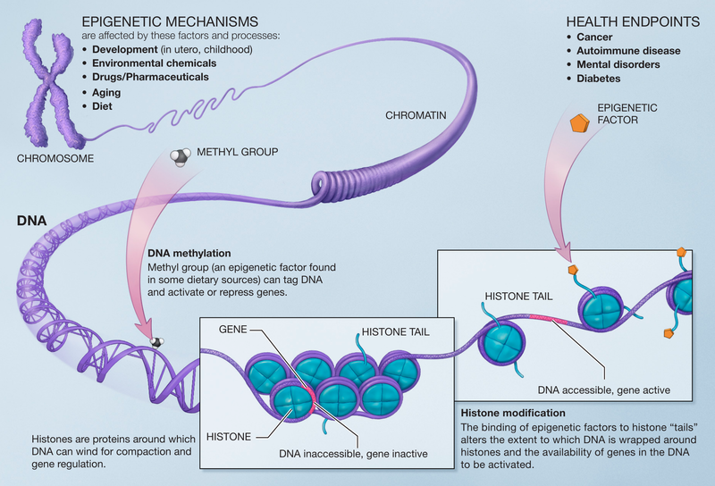
Epigenetics
Image source: https://en.wikipedia.org/wiki/Epigenetics#/media/File:Epigenetic_mechanisms.png

Slide 45
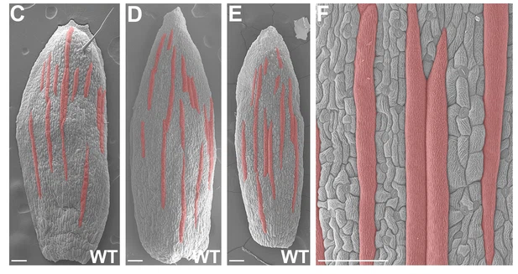
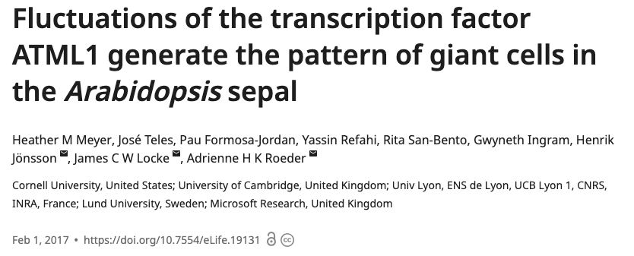
Role of epigenetics in cell differentiation

Slide 46
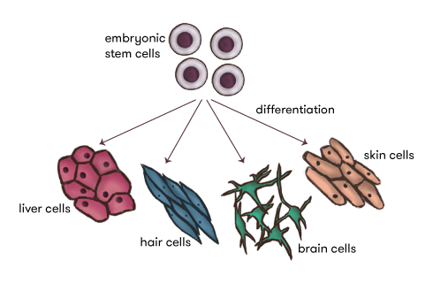
Role of epigenetics in cell differentiation
Image source: https://www.science.org.au/curious/epigenetics

Slide 47
Animated video
https://www.youtube.com/watch?v=gG7uCskUOrA

Slide 48
Measuring gene expression

Slide 49
Gene Expression: the process by which information encoded in the DNA is used to make a product (mRNA or protein)
Different gene expression patterns could be signs of interesting biological differences between cells.

Slide 50
Modern experiments allow researchers to figure out the sequence of nucleic acids (including DNA and mRNA)
Note: not to scale. Genes and mRNA transcripts are much longer than this.
CUGGCAUAC
Template strand
3’
ATGCTCGGATACGTTAGGCCATTTGACCGTATGCGTAACTGCCGATGTAGGCTATACG
TACGAGCCTATGCAATCCGGTAAACTGGCATACGCATTGACGGCTACATCCGATATGC
5’
Coding strand
5’
3’

Slide 51
mRNA transcripts can be measured experimentally

Slide 52
CUGGCAUAC
GCUACGGCA
Note: not to scale. Genes and mRNA transcripts are much longer than this.
3’
GTTAGGCCATTTGACCGTATGCGTAACTGCCGATGTAGGCTATACGATGCCGTAACGTAGCTATG
CAATCCGGTAAACTGGCATACGCATTGACGGCTACATCCGATATGCTACGGCATTGCATCGATAC
Template strand
5’
Coding strand
5’
3’

Slide 53
Abstracting this into a spreadsheet…

Slide 54
In Tumor_sample_1, 8 fragments (also called ”reads”) of cDNA (converted from mRNA) were found that mapped onto Gene 5.

Slide 55
Possible Experiment Ideas:
Tumor vs. healthy tissue
Tumor exposed to a drug candidate vs. tumor not exposed
Mice bred to have a specific genotype vs. controls
Cell line with gene “knocked out” by CRISPR vs. controls

Slide 56
Experiments that yield this type of dataset:
Bulk RNA-seq: each column is a sample with many cells.
Single Cell RNA-seq: newer method, each column is an individual cell.
Microarray: older method (little bit different, but similar format for spreadsheet)

Slide 57
Differential Expression Analysis
Let’s say we have a table like this, but with ~20,000 genes and 100s of samples.
How can we analyze this data to gain some biological insights?

Slide 58
Project 1: Analyzing Gene Expression Data

Slide 59
Idiopathic Pulmonary Fibrosis
no known cause
lungs
scarring
Causes loss of alveolar function
Median post-diagnosis survival is 2.5-3.5 years
Five-year survival: 20-40%
No cure, but treatments can slow damage and prolong life (so early detection is helpful)
Image source: https://www.nhlbi.nih.gov/health/idiopathic-pulmonary-fibrosis/causes

Slide 60
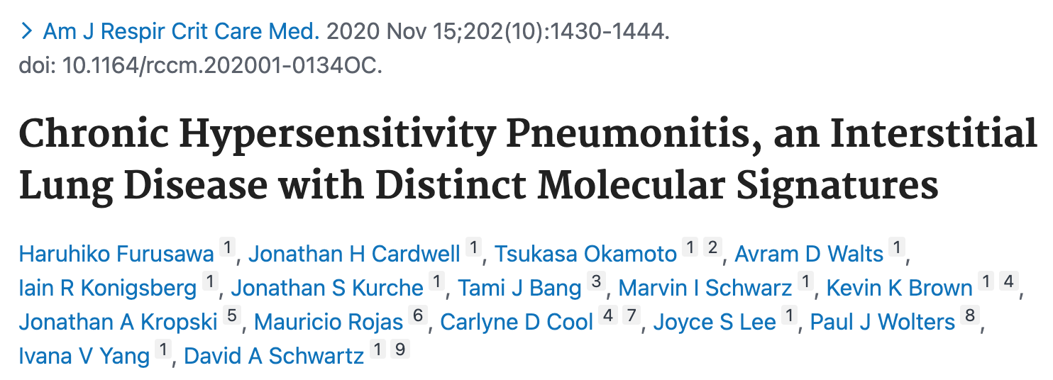
GSE150910 Dataset
Bulk RNA-seq of human lung tissue samples
18,838 genes
103 IPF samples
36 from surgical biopsies
67 from lungs removed during transplant surgery
103 non-IPF controls
41 from histologically normal portion of lung cancer biopsies
62 from deceased organ donors without lung disease
Cohorts were frequency-matched for age, sex, and race

Slide 61
Dataset format
IPF
Control

Slide 62
Dataset format
IPF
Control
Goal: look for genes with differences in expression between the two conditions.

Slide 63
Dataset format
IPF
Control
“Differential Expression Analysis”
Goal: look for genes with differences in expression between the two conditions.

Slide 64
Quick Statistics Lesson

Slide 65
What is statistics?
Basically, a way of putting a number on coincidences

Slide 66
Thought Experiment
Let’s say you have a coin, and you want to know if it’s fair (same probability of heads and tails) or biased.
How many flips would it take to know with absolute certainty that the coin is biased?
What if you flip it 3 times, and get heads every time?
What if you flip it 10 times, and get heads every time?
What if you flip it 1,000,000 times, and get heads every time?

Slide 67
Thought Experiment
Philosophical musing: it’s impossible to ever say with absolute certainty that a coin is biased. Even if you flip a coin 1,000,000 times and get heads every time, it could just be a coincidence.
But with statistics, we can at least put a number on how big of a coincidence that would be, assuming that the coin is fair.
Flipping 3 times and getting 3 heads = SMALL COINCIDENCE
Flipping 1,000 times and getting 1,000 heads = HUGE COINCIDENCE

Slide 68
Experiment
First, assume that the coin is fair (called the null hypothesis)
Experiment: flip a coin 5 times.
Result: 5 heads, 0 tails
What are the chances of a result this extreme happening by coincidence, assuming the coin is fair?
(0.5 ^ 5) * 2 = 0.0625 = 6.25% chance
(multiplying by 2, because it could have also been 5 tails by coincidence, which would have been equally as extreme)
0.0625 is called a p-value
Is the coin biased? We can’t be sure. But we can put a number on how much of a coincidence would be required to see the results we got if the coin were fair. (smaller p-value = more of a coincidence)

Slide 69
Some Jargon
null hypothesis: the assumption that nothing unusual is going on (in our example, that the coin is fair)
alternative hypothesis: another hypothesis besides the null (in our example, that the coin is biased)
p-value: the probability of seeing a result at least as extreme as the one we’re seeing due to coincidence if the null hypothesis is correct

Slide 70
IPF
Control
It looks like Gene 4 has lower expression in the IPF samples compared to the controls. Goal is to use a statistical test to try to figure out if this is a coincidence, or if there is a real underlying difference between the conditions.

